Slide 1




NEAREST NEIGHBOUR OF DIFFERENT IMAGE REPRESENTATION
PRESENTED BY ANKUR CHOWDHURY (1911844042)
& Sajid Wasif (1912313642)

Slide 2
What is our project
In 499A our project was every picture in the dataset one dimensional vector will be created and stored in the program. For each and every picture it will show 10 pictures in Euclidean distance or we can say 10 nearest neighbors. The main part for this project was to observe different types of objects and what their nearest neighbors represent the similar picture or different types of pictures and also the similarity rate for those pictures.

Slide 3
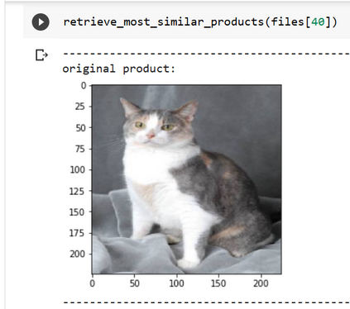
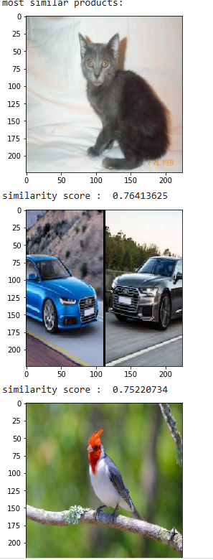
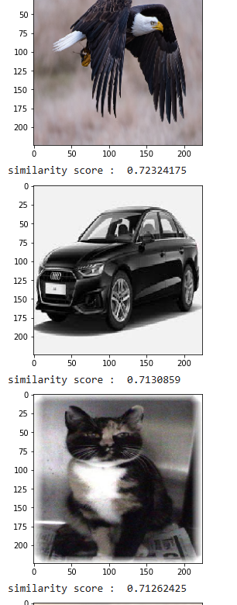
The specs:
First we Divided the dataset into 10 classes. Every class contains 100 images. Then we Imported the model Resnet101. We extracted features of the images by using two models (Resnet101 & VGG16 ). The cosine similarity score was used to determine the similarity between the images. Then we Compared accuracy between two models and decided to continue with Resnet101 as it gave better accuracy. In the output section of ResNet 101 the original image was Cat, and from the 10 nearest neighbors, we got 5 similar photos .We currently used two models but now we want to try different models like ZFnet and other CNN modes for better similarity score. We used our own dataset which was not efficient enough so we want to gradually shift the dataset to the ImageNet dataset as soon as possible.

Slide 4
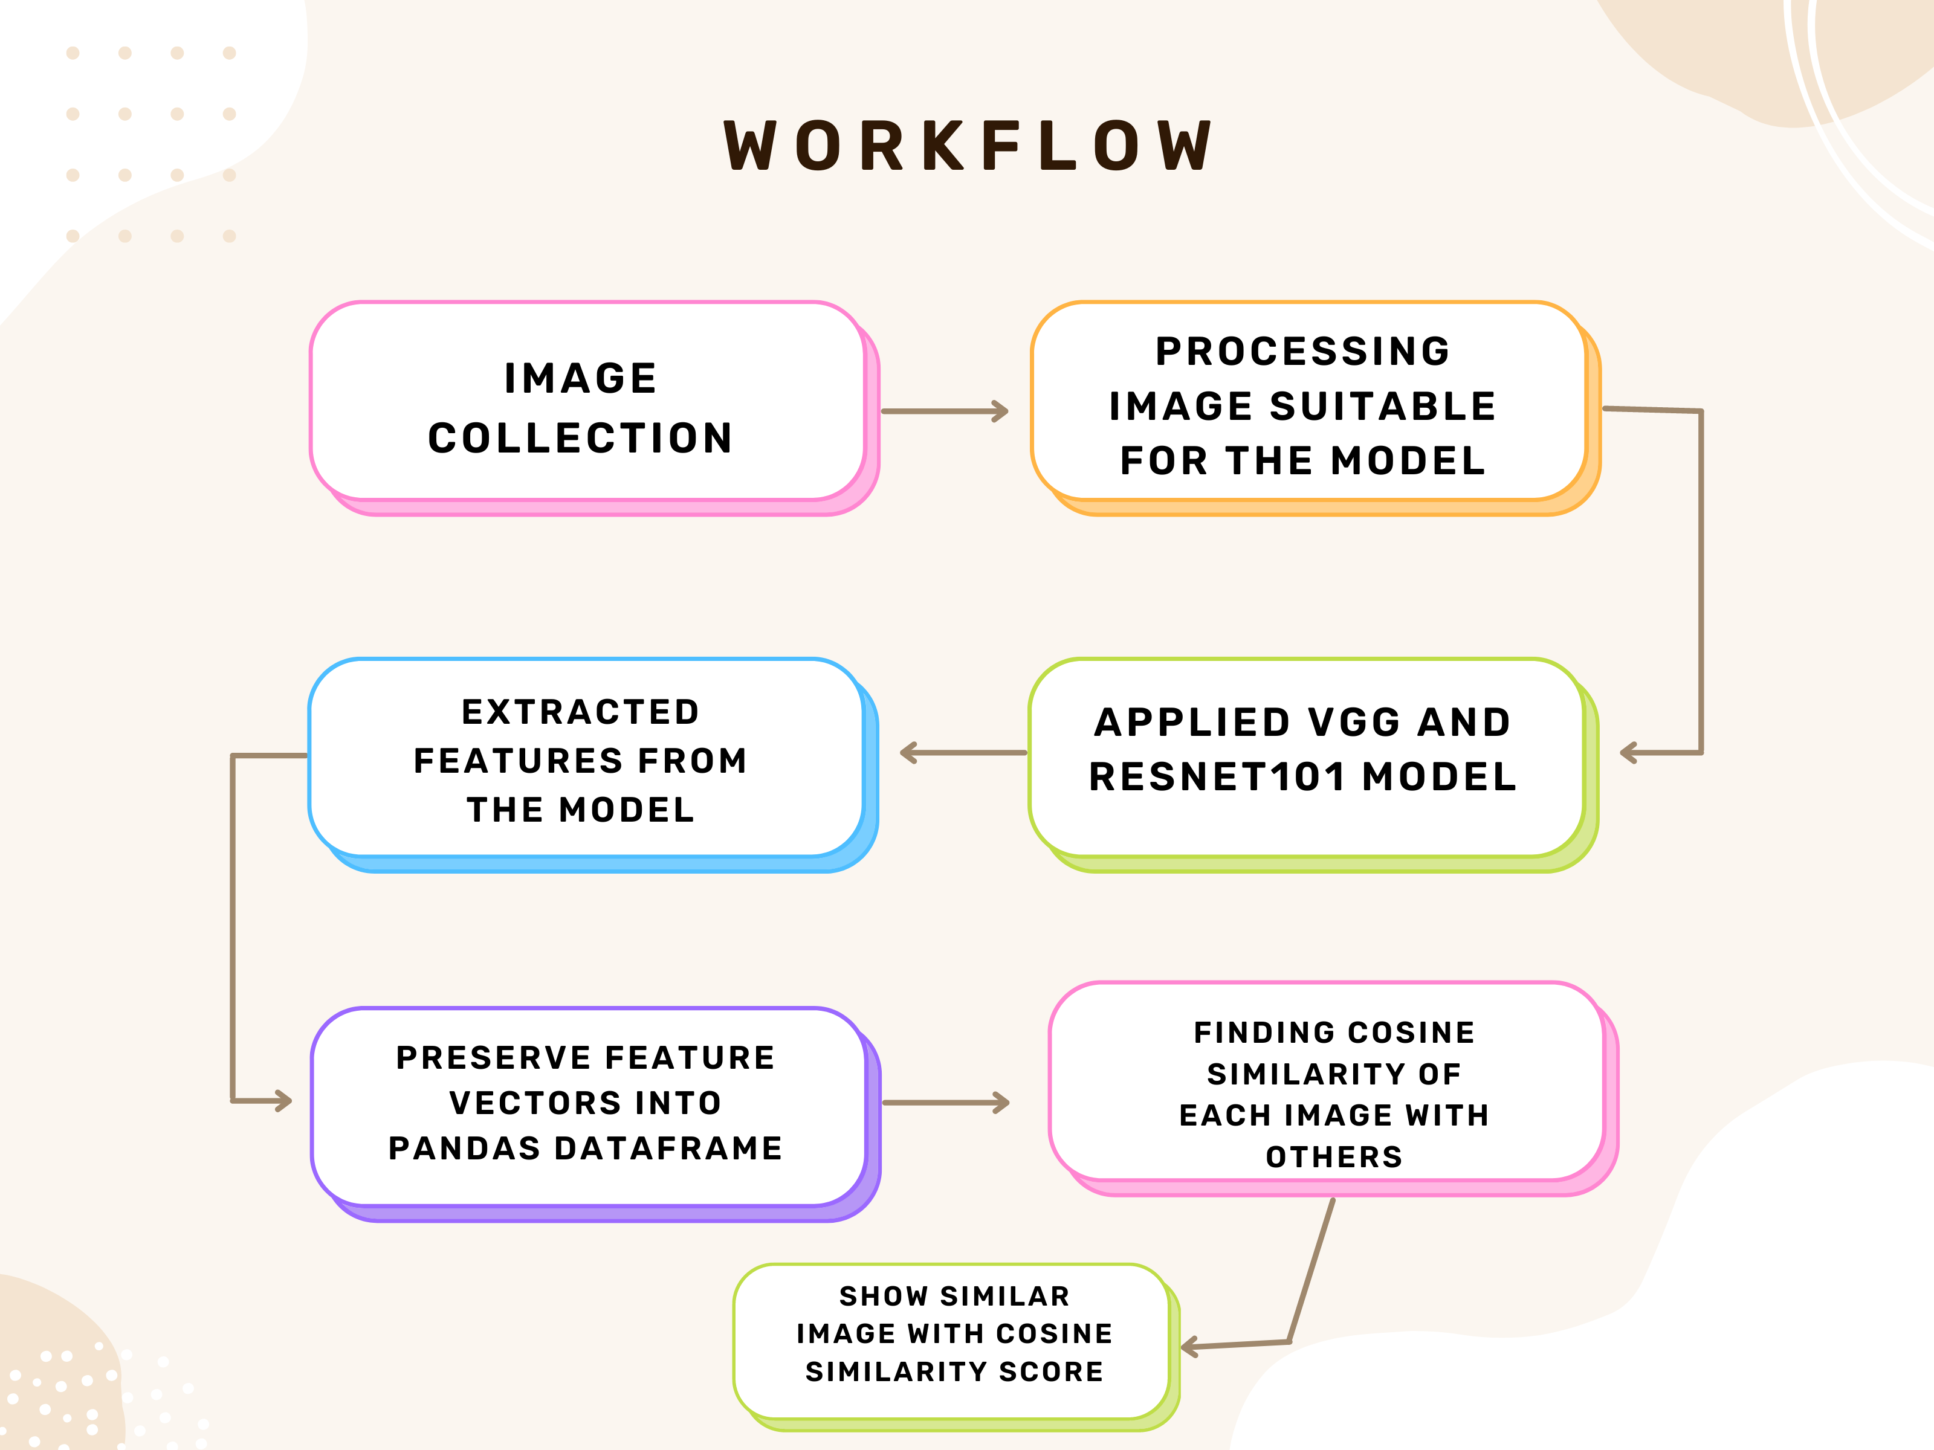

Slide 5
Outcomes from 499A
After overcoming certain obstacles, we achieved our desired outcome from 499A . we learned how deep learning methods may be used to create a feature extractor model and obtain the most comparable photos from a dataset of 10 classes of 1000 different image. We learned how to Compared accuracy between two models . The features were then extracted from the images and stored in a feature vector.

Slide 6
THANK YOU

